Slide 1
CIS694/EEC693/CIS593 Deep Learning
Hongkai Yu
Cleveland State University

Slide 2
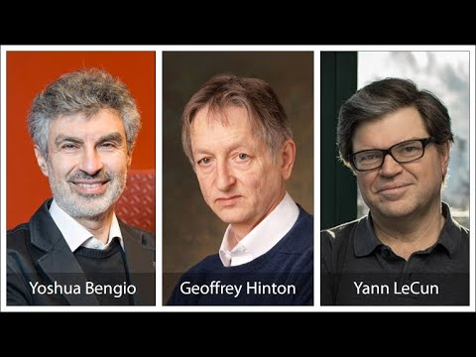
Fathers of AI
2018 ACM A.M. Turing Award
for Major Breakthroughs in Artificial Intelligence

Slide 3
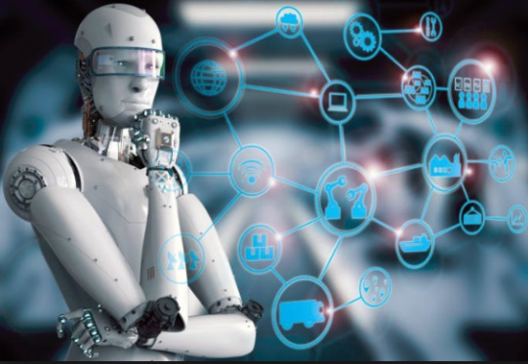
Course Description
Objective
Visual data (~90% time) & General data (~10% time) in this class
e.g., image, video e.g., general data, text
Applications: image understanding, self-driving cars, natural language processing, …

Slide 4
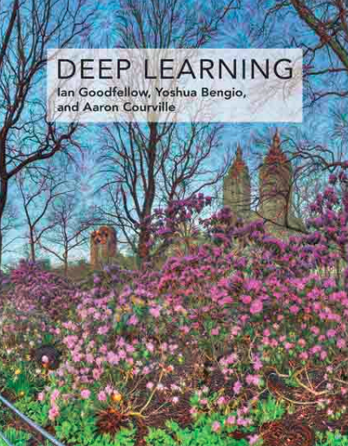
Course Description
Methodology
Deep learning
Prerequisites
Linear Algebra
Statistics and Probability
Programming in Python
Open for both undergraduate and graduate students
Deep Learning, Ian Goodfellow, Yoshua Bengio and Aaron Courville, MIT Press, 2016 http://www.deeplearningbook.org/

Slide 5
What will you learn in this course?
Start from basics
Information theory, supervised learning, unsupervised learning, Regression, classification, clustering
Go further to deep learning
NN, CNN, FCN
R-CNN, GAN, Transfer Learning, Attack, …
Practical projects
image classification, object detection,
semantic segmentation, data prediction,
natural language processing, …

Slide 6

What will you learn in this course?
Theories about deep learning
Convolution, pooling,
Fully connected, optimization, …
Hands-on experience in deep learning
Transfer learning, fine-tune,
Hyper-parameters setting, …
Popular programming tools

Slide 7
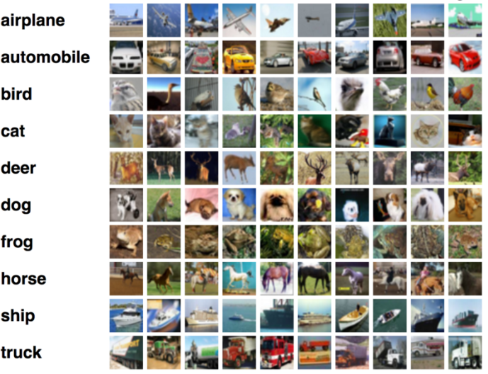
What can you do after this course?
Image classification

Slide 8
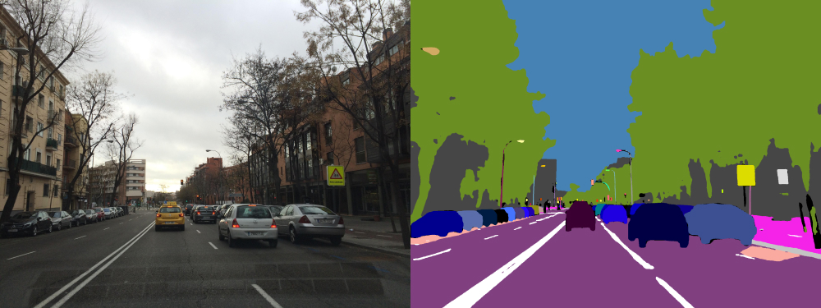
What can you do after this course?
Semantic
segmentation

Slide 9
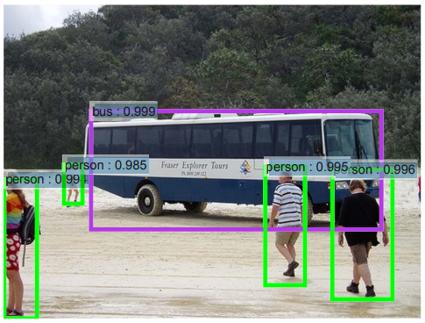
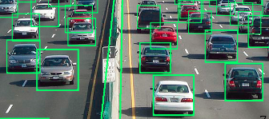
What can you do after this course?
Object detection

Slide 10
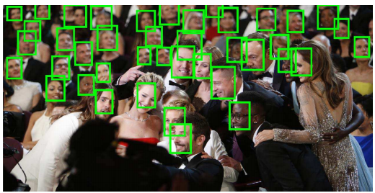
What can you do after this course?
Face detection and recognition

Slide 11
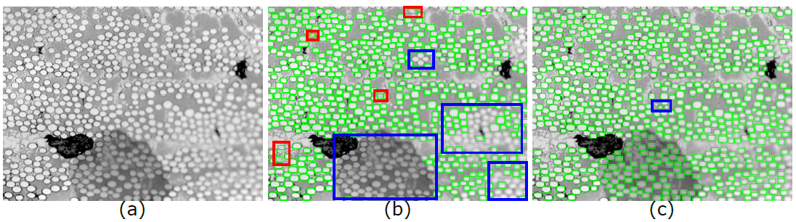
What can you do after this course?
Fiber detection funded by Air Force Research Lab
0.2 seconds per image by our method with a 1080 Ti GPU

Slide 12
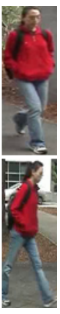
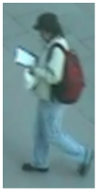
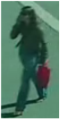
What can you do after this course?
Person
re-identification

Slide 13
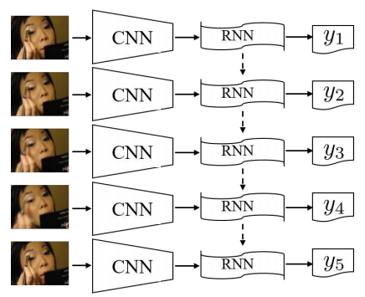
What can you do after this course?
Action recognition
http://openaccess.thecvf.com/content_ICCV_2017/papers/Shi_Learning_Long-Term_Dependencies_ICCV_2017_paper.pdf

Slide 14
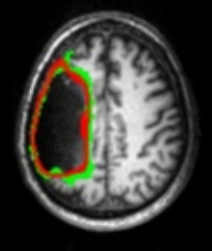
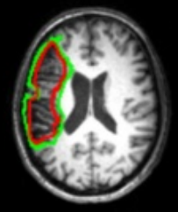
What can you do after this course?
Medical image computing

Slide 15
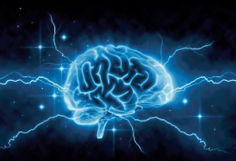
What can you do after this course?
10, 30, 5, 2, 11
General data analysis
CNN/RNN
2, 5, 10, 11, 30

Slide 16
What can you do after this course?
Traffic speed in the past 5 hours
General data analysis
CNN/RNN
Traffic speed in the next 30 mins

Slide 17
What can you do after this course?
A small to medium primate
that typically has a long tail
General data analysis
CNN/RNN
‘monkey’: 0.7, ‘dog’: 0.2, …
http://cs224d.stanford.edu/reports/O'Neal.pdf

Slide 18
What can you do after this course?

Slide 19
What can you do after this course?

Slide 20
What can you do after this course?

Slide 21
What can you do after this course?

Slide 22
What can you do after this course?

Slide 23
What can you do after this course?
Perception
Multi-sensors
Motion Planning
Control
Autonomous Driving Framework

Slide 24
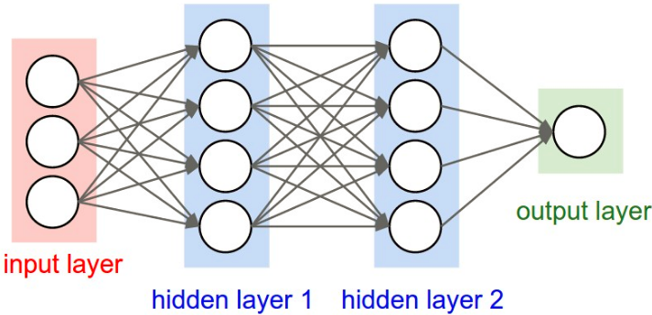
History of deep learning
NN, Multi-layer Perceptron, Backpropagation
1970s, 1980s

Slide 25

History of deep learning
Convolutional Neural Networks (CNN), 1990s
Named as LeNet
Recognize handwritten ZIP codes on mail
http://yann.lecun.com/exdb/lenet/index.html

Slide 26
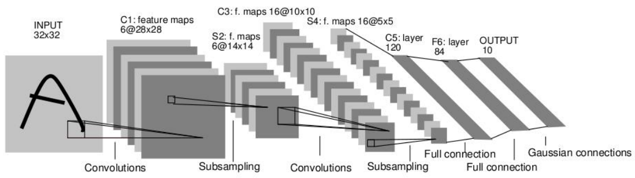
History of deep learning
Convolutional Neural Networks (CNN), 1990s
LeNet is very accurate for handwritten recognition
Needs 3 days to train the LeNet on 60K images in 1990

Slide 27
History of deep learning
ImageNet Dataset:
15 million images with manual annotations
Large Scale Visual Recognition Challenge, since 2010
AlexNet:
First Place in ImageNet Challenge, 2012
Image classification
Training set: 1.2 million images of 1000 classes
Testing set: 150K images of 1000 classes

Slide 28
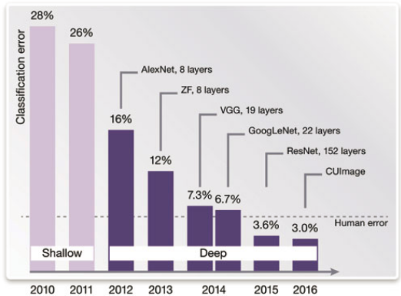
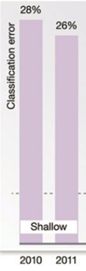
History of deep learning
ImageNet Challenge

Slide 29
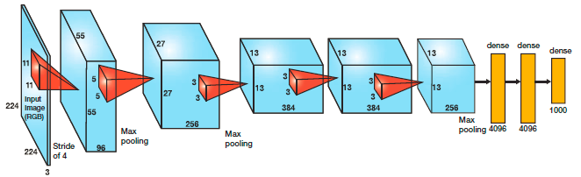
History of deep learning
AlexNet for image classification, 2012
ImageNet Dataset: 1.2 million training images
Takes 5 days to train on two GTX 580 3GB GPUs

Slide 30
History of deep learning
After 2012: deep learning is everywhere
Speech recognition
Natural language processing
Recommendation system
Bioinformatics
Security
Go match: AlphaGo
Self-driving cars
…

Slide 31
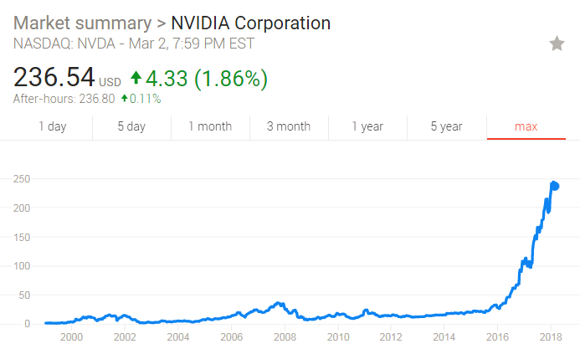
Question
Why deep learning is suddenly changing your life around the year of 2012?
Algorithm: improved network structures
Data: large-scale datasets (ImageNet)
Hardware: powerful computation (GPU)

Slide 32
Introduction: NLP
A small to medium primate
that typically has a long tail
Using word2vec or GloVe, each word could be represented as a N-dimensional vector:
11
.
.
.
N
Each row is a N-dimensional vector that represents one word.

Slide 33
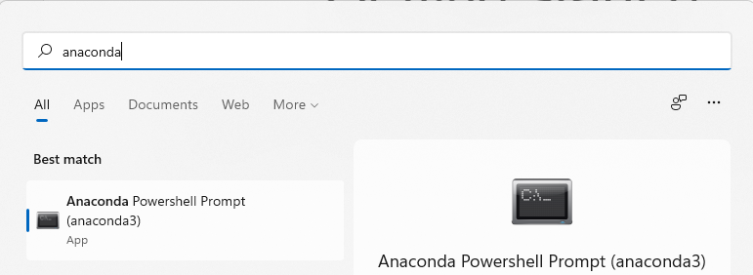

Getting started
Windows OS: Download and Install Anaconda (Python 3 version) (Anaconda is a data science platform powered by Python. It includes over 100 of the most popular Python packages.)
Download and install PyCharm as the IDE

Slide 34
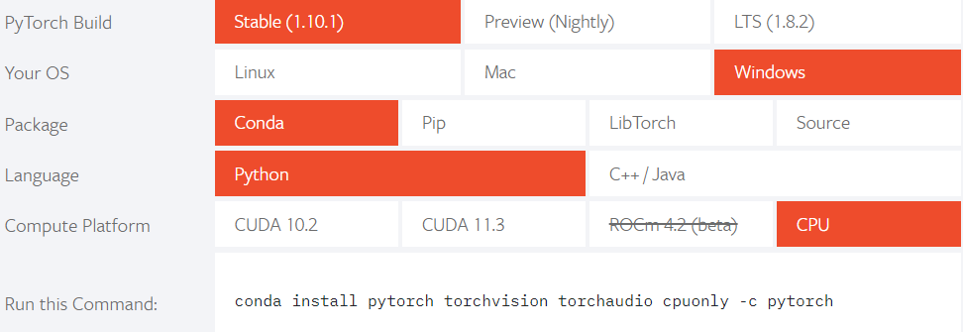
Getting started
Windows OS: Install PyTorch (CPU version) by running a command in Anaconda terminal
https://pytorch.org/

Slide 35
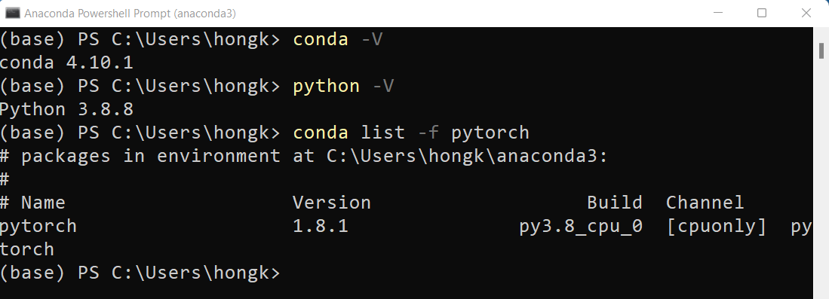
Getting started
Check installed version in Anaconda terminal:

Slide 36
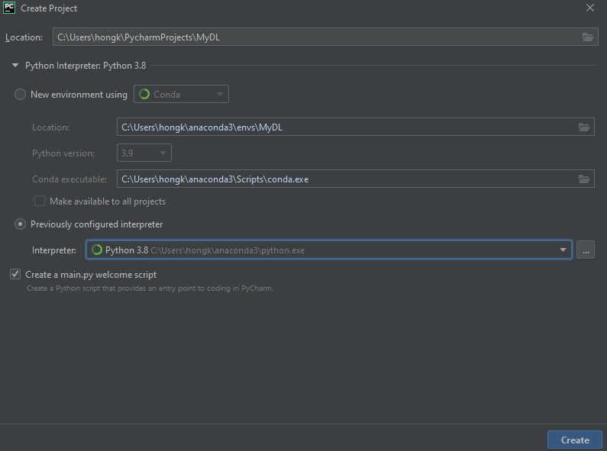
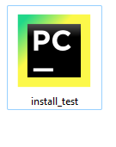
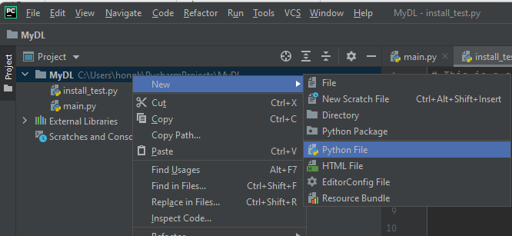
Getting started

Slide 37
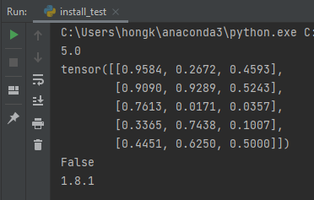
Getting started
# This is a sample Python3 script to test whether packages are installed successfully or not. import numpy as np import torch import scipy as sp import matplotlib as plot import sklearn as skl #import cv2 print(np.sqrt(25)) x = torch.rand(5, 3) print(x) print(torch.cuda.is_available()) print(torch.__version__) #print(cv2.__version__)

Slide 38


